Slide 1
Deepening Analysis: going beyond PEA for Literature
Key: Red = Use always
Orange = Use when able to
Green = Top level developments
What you should/could cover in developed analysis:
Link to the question
Link to the terminology (Lang/Structure – evaluating choice)
Short Quote(s)
Explain meaning and effect – both obvious and hidden (explicit and implicit)
Zoom in on words/explore connotations and effect
Suggest what other readers might think/feel (offering an alternative opinion)
Link to the writer’s intentions (step out from the close analysis to give an overview of meaning)
Explore a linking quote/supporting idea
For A Christmas Carol or The Poetry Anthology – Link to context
Suggestions of sentence stems that can support engaging with deeper analysis:
In the text… the reader learns…
The ________ (insert terminology) emphasises how…
This suggests/implies/infers/creates/…
Looking carefully at _____ (insert word class/connotations) in “(ONE WORD QUOTE)” gives the impression that…
This emphasises/encourages readers to…
The effect created is… or Readers might/could/may feel…
Perhaps the writer (OR INSERT AUTHOR SURNAME) wants us…
Another example/quote “(INSERT QUOTE) also suggests etc…
Contextually, this is important as…
Remember, the steps above don’t have to be followed exactly and you don’t have to do every step, every time you analyse, but to reach the highest grade this will help!

Slide 2
Understanding Concise Analysis: For Language
What you should/could cover in concise analysis 1A Fiction questions A2, A3 & A4 and 2A question Non-Fiction A2:
Link to the question
Link to the terminology
Quote(s)
Explain meaning – both obvious and hidden (implicit and explicit)
Explore the effect of the language/structure
Suggestions of sentence stems that can support engaging with concise analysis:
In the extract… we see…
The ________ (insert terminology)…
Supporting this “(QUOTE)” …
This suggests/implies/infers/creates/…
The effect created is… or Readers might/could/may feel…
Concise = short and snappy – quickly getting to the point
Fiction
A2 = 4 – 5 quotes
A3 = 7 – 8 quotes
A4 = 7 – 8 quotes
Non Fiction
A2 = 7 – 8 quotes
Remember, the steps above don’t have to be followed exactly and you don’t have to do every step, every time you analyse, but to reach the highest grade this will help!

Slide 3
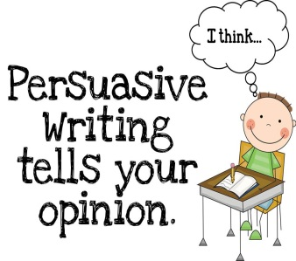
Understanding the Evaluation Questions – using evidence and opinions
What you should/could do to show you can evaluate persuasively Fiction A5 and Non-Fiction A4:
Link to the question
Give a quote which links to your idea
Explain briefly what the quote means
Explain your own opinion in relation to the question
Explain what other reader suggest or predict what other readers might contradict your opinion or point with. You can offer a range of opinions on one supporting quote
Sentence stems you can use to help you evaluate a text:
The extract makes me think (refer to question key words)
The quote which suggests this is (QUOTE)…
This means…however,
I think/feel/imagine
Other reader may say…/Alternatively, it could be seen as…
Remember, the steps above don’t have to be followed exactly and you don’t have to do every step, every time you evaluate, but to reach the highest grade this will help!

Slide 4
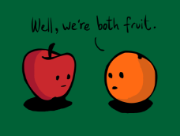
Understanding how to Compare
Comparing (similarities) Compared with… Similarly… In the same way… Likewise… Equally… As with… …are similar in that…
Contrasting (differences) However…
In Contrast, On the other hand… On the contrary… As for… Alternatively… Despite this… …whereas… …while... …although… …yet…
Remember, you can change the structure of your comparison, when you are confident
Things to consider comparing: Ideas, themes, writers’ intentions, tone & mood/atmosphere, imagery, narrative voice, techniques (language & structure), shift of focus, endings/beginnings…
What you should/could do to show you can compare Non-Fiction A6 & The Anthology & Unseen Poems:
Link to the question for both texts stating the similarity or difference
Give a quote which links to your idea from TEXT 1
Explain briefly what the quote means
Use comparative connectives in your answer to then explain a quote from TEXT 2 and HOW the quotes are different or the same and what they make you think
Model you can use to help you compare in a text:
In both texts the reader can see ________is a similarity/difference.
In TEXT 1, this is evident in the line “_______________” which suggests ____________________
However, this is unlike/similar to TEXT 2 in the line “_____________” which implies_______________

Slide 5
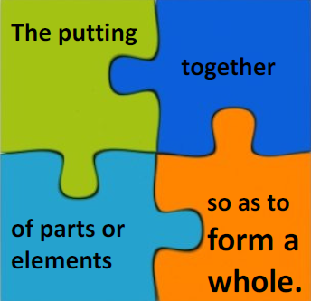
Understanding how to Synthesise information
Remember, you need to cover a range of quotes from both texts to draw together the information
What you should/could do to show you can synthesise information for Non Fiction A5:
Link to the question for both texts stating the similarity or difference (depending on what has been asked for in the question)
Give two quotes which links to your idea – must be from both texts
Explain briefly what the quote shows you in terms of the similarity or difference (DO NOT COMPARE)
Ensure you have stated information from both texts
Sentence stems you can use to help you synthesise in a text:
In both texts we see… which shows me…
The quote from Text 1 which supports this is “QUOTE”, and the text 2 “QUOTE”
Both these quotes tell me…

Slide 6
WET RATS How to apply WET RATS in analysis
First create the key in different colours in your book. When you have completed this it will be a checklist for analysis. Before you use WET RATS ensure you have:
Linked to the question (which means you have made a point)
W – Words (zoom in)
E – Effects or embedded quotations
T – Techniques – language or structure
R – Reader’s reaction
A – Author’s intentions/alternative opinions
T – Themes/time - which is context S - Structure

