Slide 1
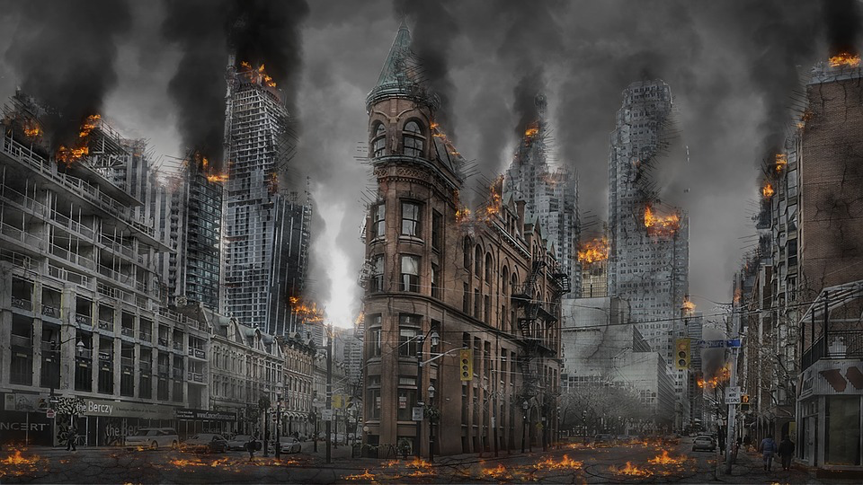
‘An Inspector Calls’ Lecture: Beauty, Crime, Feminism and the Apocalypse

Slide 2
Beauty –why the focus on it?
Inspector describes Eva Smith as ‘not pretty’ after the death but alive she had been ‘very pretty’
Birling describes her as a ‘good looking girl’
Gerald refers to Eva Smith (Daisy Renton) as ‘pretty’- ‘soft brown hair and big dark eyes’
Eric describes her as ‘pretty’ and a ‘good sport’
Maybe Priestley is emphasising ‘pretty’ as connotations of good looks, but also something delicate and sweet, something that was not cared for but ruined.
Priestley may also be seeking to pit his tragic heroine against the ugliness of the Capitalist world, and a heartless class-led society
Sheila is also described as being ‘pretty’ in stage notes
There are several links between the two women, and this one strengthens Sheila’s empathy, and how in different circumstances, it could have been her.
Gerald is described as ‘attractive’ in the stage notes
Perhaps Gerald is an ‘attractive’ option at first to three people for different reasons: –Mr Birling, Sheila and then Eva/Daisy?

Slide 3
Watch out for the Stage Directions!
Try and acknowledge one or two.
e.g. In the line ‘At the start, Priestley emphasised any actor playing Sheila would need to appear ‘very pleased with life and rather excited’ therefore the audience learns early on that her contentment is set up to be likely dismantled, while her excitement is gently transformed by the Inspector from a youthful hysteria to a kind of wise, moral purpose as the play progresses.
e.g. Priestley uses the dramatic device of a piercing ring sound to both begin and complete the powerful circular narrative. At the beginning, a doorbell interrupts Birling’s pompous, misguided Capitalist rant, whilst at the end, a phone rings to signal a girl really has died, and a police officer is on his way.

Slide 4
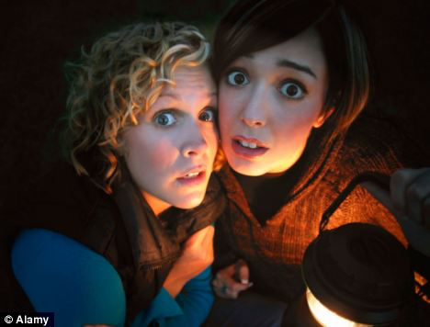
Stage Directions (Continued) It’s all about the looks!
‘Gerald and Eric exchange uneasy glances’ (before the revelation about Gerald’s affair)
‘Birling and Mrs Birling exchange bewildered
and rather frightened glances’
(Shortly before Eric’s involvement is revealed)
There is a real sense of fear, secrets, and confusion from the family that is supported by the stage directions which instruct quick glances.
Interesting to note the Inspector often ‘STARES’ and looks ‘Steadily and searchingly’ as if trying to see through to people’s souls?

Slide 5
FORM: The Crime thriller
A gripping tense genre where the audience enjoys
working out from the clues provided who committed
the crime and who was ultimately responsible.
We have many clues – Eric’s drinking, Gerald not being at the works in the summer, etc.
The play is structured to reveal cliff-hanger moments at the end of each Act – Gerald’s affair (End Act 1), Mrs Birling suddenly realising she may have damned her own son (End Act 2)
But Crime Thrillers normally have loose ends tied up. An Inspector Calls subverts this with its open ending. How will the characters now react?

Slide 6
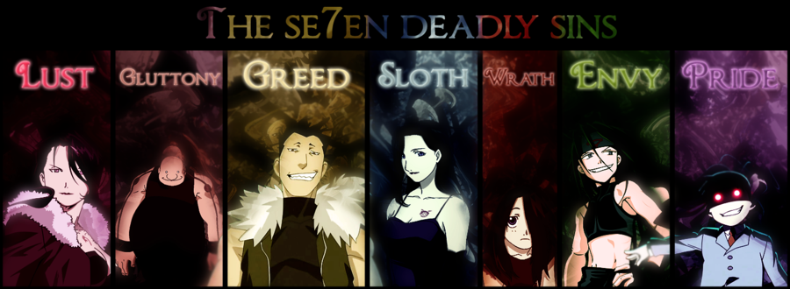
FORM: The Morality Play
Popular during the 15th and 16th-centuries. Historically they sought to teach the audience lessons that focused on the seven deadly sins: lust, gluttony, greed, sloth, wrath, envy and pride.
Whilst characters who committed these sins were punished,
morality plays showed that if a character repented then they could redeem themselves.
Think for a minute, which of these sins match up with different characters?
Which characters repent? Which only do half-heartedly, and for ulterior motives?

Slide 7
Sheila and Eva are early feminists
Eva works and has a strong voice, protesting against low pay
She tries not to be dependent on a man, doesn’t pressurise Gerald or Eric for anything once their feelings are made clear to her. She also goes to a Women’s charity for support.
Sheila slowly starts to recognise the need for change: ‘These girls aren’t cheap labour, they’re people’
The Inspector fights for Sheila to have a right to stay and listen, not be sheltered from the truth: ‘So you think young women should be protected against unpleasant and disturbing things?’
Look at the difference compared to the older generation and their entrenched patriarchy from the Late Victorian era!
Mrs Birling – ’I think Sheila and I had better go into the drawing room and leave you men’ –
Mr Birling – ‘You've got to remember, my boy, that clothes mean something quite different to a woman. Not just something to wear – and not only something to make 'em look prettier – but – well, a sort of sign or token of their self-respect.’

Slide 8
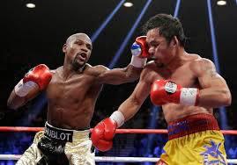
Characters’ anger with one another escalates during the play
Act 1
Eric is acting ‘sulkily’
Birling acts ‘rather angrily’ towards Eric’s
challenges.
Act 2
Sheila grows in confidence ‘cutting in’ on people, but becomes ‘distressed’ on several occasions, particularly regarding her mother’s attitude.
Birling is ‘Thunderstruck’ by the end of the scene.
Act 3
Birling is described as acting ‘explosively’ , ‘savagely’ towards Eric
Eric is ‘nearly at breaking point’ and ‘threatening’, ‘ bursting out’,
Sheila is described as ‘flaring up’

Slide 9
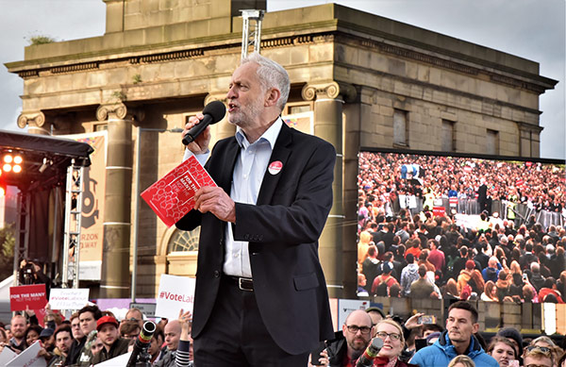
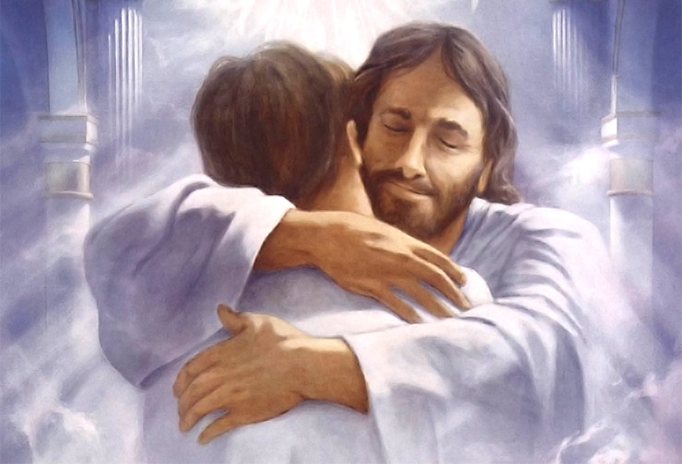
The Inspector’s final speech
‘Apocalyptic socialism’ , ‘Pacifist prophecy’ or ‘Christian Parable’?
‘But just remember this. One Eva Smith has gone – but there are millions and millions of Eva Smiths and John Smiths still left with us, with their lives, their hopes and fears, their suffering and chance of happiness, all intertwined with our lives, with what we think and say and do. We don’t live alone. We are members of one body. We are responsible for each other. And I tell you that the time will soon come when, if men will not learn that lesson, then they will be taught it in fire and blood and anguish. Good night.’

Slide 10
Acknowledgements
Chris Curtis – Beauty / Increasing anger prompts
Tim Martin, The Telegraph – ‘Final Speech apocalypse’

