Slide 1
Revision Guide – Extra Boost over the summer
Anthology
A single poem essay – 20 minutes
A comparison poem essay – 40 minutes
You must include context
Use slide four guidance on analysis
Creative Writing
A short story that includes the information you have been asked to include and which is self edited.
Romeo and Juliet
Tasks which help you show your understanding of the play
(analysis and reading)
A1 to A5 Fiction
Practice analysis for A1 to A5 style questions
Use slide four for guidance on how to analyse

Slide 2
This booklet has lessons and information to help you revise each slide from 5 onwards is at least an hour of work per slide ☺ Enjoy
Contents
Context to learn for the war poems (when working on the poem lessons)
Lesson 1 – The Manhunt (analysis)
Lesson 2 – Creative Writing Challenge (writing skills)
Lesson 3 – The Soldier (analysis)
Lesson 4 – A1 to A5 practice tasks On Lord of the Flies (analysis)
Lesson 5 – A Wife in London (analysis)
Lesson 6 – Romeo and Juliet Challenge (reading & understanding & analysis)
Lesson 7 – Dulce Et Decorum Est (analysis)
Lesson 8 – Mametz Wood (analysis)
Lesson 9 – Extension Tasks on Poetry – essay on one of the poems with context (see extra help on structures)

Slide 3
Poem | Quote | Context Link
The Manhunt By Armitage | “handle and hold” “Parachute silk of the punctured lung” “only then would I come close” | Eddie’s wife Laura is discovering how fragile Eddie is after being shot. The first line of each couplet reinforces this and the structure also indicates that they are a couple getting through this together. The bullet that shot Eddie Beddoes ricocheted through his body, damaging many of his internal organs. Emotional damage and trauma suffered by Eddie as a result of being shot on a peacekeeping mission – he feared balloons at his children’s parties and suffered PTSD because of the trauma.
The Soldier By Brookes | “forever England” “blest by suns of home” “English heaven” | The patriotism in the poem suggests that even in death glory will come to the soldiers who have fought and died for their country. Brooke’s never experienced the true horror of war and this is clear from the hyperbolic tone in the poem – the tone here indicates that the poem was written prior to the outbreak of war. Propaganda poem to encourage young men to sign up to become soldiers and the overtly sentimental feeling in the final line may have encouraged men to see becoming a soldier as a higher calling.
A Wife in London By Hardy | “The Tragedy” “The Irony” “in the far South Land” | A telegram was received from the war office, which for a wife at home with a husband away in the Boer war in South Africa, would have signalled bad news. A letter is received by the wife the day after the telegram explaining the excitement of the husband to be coming home. South Africa is referenced here and would have reinforced the reality for many women, whose husbands were away fighting in the Boer war, with little correspondence or understanding of when they would be back.
War Context linked to specific quotes from the Anthology – Your task – create your own charts with other examples
Dulce Et Decorum Est By Owen | “like old beggars under sacks” “But limped on, blood-shod” “The old lie” | Reflects that young men looked worn out and old before their time as a result of the terrible conditions and events they endured during the war. Having lost their boots or having constantly wet feet many men suffered horrific injuries such as trench foot which was a disease that meant amputation for many, however at the time they had to carry on in spite of the hardships and pain. Reinforces the fact that the army and the government were unaware of what was going to happen in the war and that when they did know they continued to use propaganda to encourage men to go to war. Thousands of men lost their lives due to the ‘lies’ or propaganda that encouraged them to go to war.
Mametz Wood By Sheers | “For years afterwards” “to walk not run” “absent tongues” | The effect of the war was devastating and long-lasting as even when war had finished many bodies of men who fought in war had not been recovered. Links to the instructions given to the soldiers by the commanding officers who had no idea of the brutality that was to come. It could suggest that the officers were incompetent or that the horror and barbarity with the new machinery (like machine guns) was unprecedented. Sheers wanted to reinforce the fact that many of the Welsh soldiers who went to war were not given a voice and were not remembered for the part that they played in the war. By reinforcing this in the poem it gives them back a voice and tells the story of what happened to their brigade at Mametz Wood.

Slide 4
Concise Analysis System
Key: Red = Use always
Orange = Use when able to
Green = Top level developments
What you should/could cover in developed concise analysis:
Link to the question
Link to the terminology (Lang/Structure – evaluating choice)
Short Quote(s)
Explain meaning and effect – both obvious and hidden (explicit and implicit)
Zoom in on words/explore connotations and effect
Suggest what other readers might think/feel (offering an alternative opinion)
Link to the writer’s intentions (step out from the close analysis to give an overview of meaning)
Explore a linking quote/supporting idea
Literature – For some texts you will – Link to context
Remember, the steps above don’t have to be followed exactly and you don’t have to do every step, every time you analyse, but to reach the highest grade this will help!

Slide 5
Transform: Create a story or a summary of the poem explaining what happens in the poem and how his mental and physical injuries are presented. Or, create a visual representation of the poem.
Plan your transform task:
The Manhunt
After the first phase,
after passionate nights and intimate days,
only then would he let me trace
the frozen river which ran through his face,
only then would he let me explore
the blown hinge of his lower jaw,
and handle and hold
the damaged, porcelain collar-bone,
and mind and attend
the fractured rudder of shoulder-blade,
and finger and thumb
the parachute silk of his punctured lung.
Only then could I bind
the struts and climb the rungs of his broken ribs,
and feel the hurt of his grazed heart.
Skirting along, only then could I picture the scan,
the foetus of metal beneath his chest
where the bullet had finally come to rest.
Then I widened the search,
traced the scarring back to its source
to a sweating, unexploded mine
buried deep in his mind, around which
every nerve in his body had tightened and closed.
Then, and only then, did I come close.
Consider: What was Simon Armitage saying literally, metaphorically & symbolically?
What can we learn from the poem?
How can we change our behaviour or society’s behaviour based on these lessons?
What society without a need for Peacekeeping missions would look like?
Criticise: “The poem is too personal and almost uncomfortable to read due to the revelations about Eddie and his wife Laura’s pain and suffering”
Challenge this statement
Prioritise: Choose your top five quotes from the poem and explode them with:
Meaning/Effect
Zooming in on a word in the quote
Use triplets to develop your ideas
Focus on context
Exploration of the connotations
Exploration of the context that links & why

Slide 6
Creative Writing Challenge
Success Criteria
Advanced vocabulary
Punctuation – Use a variety and a variety of sentence structures: minimum – FS, CL, Commas
More advanced : ; - () ! ?
simple, compound & complex
Vary sentence openers using PANIC
Use techniques such as imagery and sibilance etc. to show you are skilled at crafting language
Craft your story deliberately to create a specific effect

Slide 7
Transform: Black out some of the words you consider to be key to the meaning of the poem. Explain how it changes the poem.
Consider: Why this propaganda poem may upset and offend some people?
What was Brooke’s implying about conscientious objectors? (research if you need to)
What a white feather symbolised in war time? (research)
The Soldier
If I should die, think only this of me:
That there’s some corner of a foreign field
That is for ever England. There shall be
In that rich earth a richer dust concealed;
A dust whom England bore, shaped, made aware,
Gave, once, her flowers to love, her ways to roam,
A body of England’s, breathing English air,
Washed by the rivers, blest by suns of home.
And think, this heart, all evil shed away,
A pulse in the eternal mind, no less
Gives somewhere back the thoughts by England given;
Her sights and sounds; dreams happy as her day;
And laughter, learnt of friends; and gentleness,
In hearts at peace, under an English heaven.
Criticise: “The Soldier is an abomination of a poem, as it persuaded hundreds of innocent men to sign up to almost certain death”
Challenge this statement
Prioritise: Choose your top five quotes from the poem and explode them with:
Meaning/Effect
Zooming in on a word in the quote
Use triplets to develop your ideas
Focus on context
Exploration of the connotations
Exploration of the context that links & why

Slide 8
A1 to A5 Practice
Simon turned away from them and went where the just perceptible path led him. Soon high jungle closed in. Tall trunks bore unexpected pale flowers all the way up to the dark canopy where life went on clamorously. The air here was dark too, and the creepers dropped their ropes like the rigging of foundered ships. His feet left prints in the soft soil and the creepers shivered throughout their lengths when he bumped them.
He came at last to a place where more sunshine fell. Since they had not so far to go for light creepers had woven a great mat that hung at the side of an open space in the jungle; for here a patch of rock came close to the surface and would not allow more than little plants and ferns to grow. The whole space was walled with dark aromatic bushes, and was a bowl of heat and light. A great tree, fallen across one corner, leaned against the trees that still stood and a rapid climber flaunted red and yellow sprays right to the top.
Simon paused. He looked over his shoulder as Jack had done at the close ways behind him and glanced swiftly round to confirm that he was utterly alone. For a moment his movements were almost furtive. Then he bent down and wormed his way into the centre of the mat. The creepers and bushes were so close that he left his sweat on them and they pulled together behind him. When he was secure in the middle he was in a little cabin screened off from the open space by a few leaves. He squatted down, parted the leaved and looked out into the clearing. Nothing moved but a pair of gaudy butterflies that danced round each other in the hot air. Holding his breath he cocked a critical ear at the sounds of the island. Evening was advancing towards the island; the sounds of the bright fantastic birds, the bee sounds, even the crying of the gulls that were returning to their roosts among the square rocks, were fainter. The deep sea breaking miles away on the reef made an undertone less perceptible than the susurration of the blood.
Simon dropped the screen of leaves back into place.
A1 – Read paragraph 1 and then list 5 things we are told about the setting. [5] (Listing the information)
A2 – Read paragraph 3. How does the writer show what Simon is like? [5] (analyse 4 – 5 quotes)
A3 –Read the whole passage. What impression do you get of the setting? [10] (language and effect 7 – 8 quotes)
A4 – Read the whole passage. How does the writer make the extract tense and dramatic? [10] (tension/structure and language 7 – 8 quotes)
A5 – “Some readers argue that this passage is dark and foreboding.” How far would you agree with this statement with reference to the whole text? [10] (7 – 8 quotes evidence and opinion – I think and I feel)

Slide 9
Transform: Create a storyboard of the events in the poem. Do this chronologically and include a summary of how the wife feels during different elements of the poem
A Wife in London I--The Tragedy
She sits in the tawny vapour That the City lanes have uprolled, Behind whose webby fold on fold Like a waning taper The street-lamp glimmers cold. A messenger's knock cracks smartly, Flashed news is in her hand Of meaning it dazes to understand Though shaped so shortly: He--has fallen--in the far South Land . . .
II--The Irony 'Tis the morrow; the fog hangs thicker, The postman nears and goes: A letter is brought whose lines disclose By the firelight flicker His hand, whom the worm now knows:
Fresh--firm--penned in highest feather - Page-full of his hoped return, And of home-planned jaunts by brake and burn In the summer weather, And of new love that they would learn.
Consider:
Why did Hardy choose to show the grief unfolding in this poignant way? (look up poignant if you need to)
What effect does the repetition of the pathetic fallacy have on the mood and atmosphere of the poem?
Prioritise: Choose your top five quotes from the poem and explode them with:
Meaning/Effect
Zooming in on a word in the quote
Use triplets to develop your ideas
Focus on context
Exploration of the connotations
Exploration of the context that links & why
Criticise: “Women were the forgotten hero’s of any war time”
Decide how you could support this statement using evidence from the poem

Slide 10
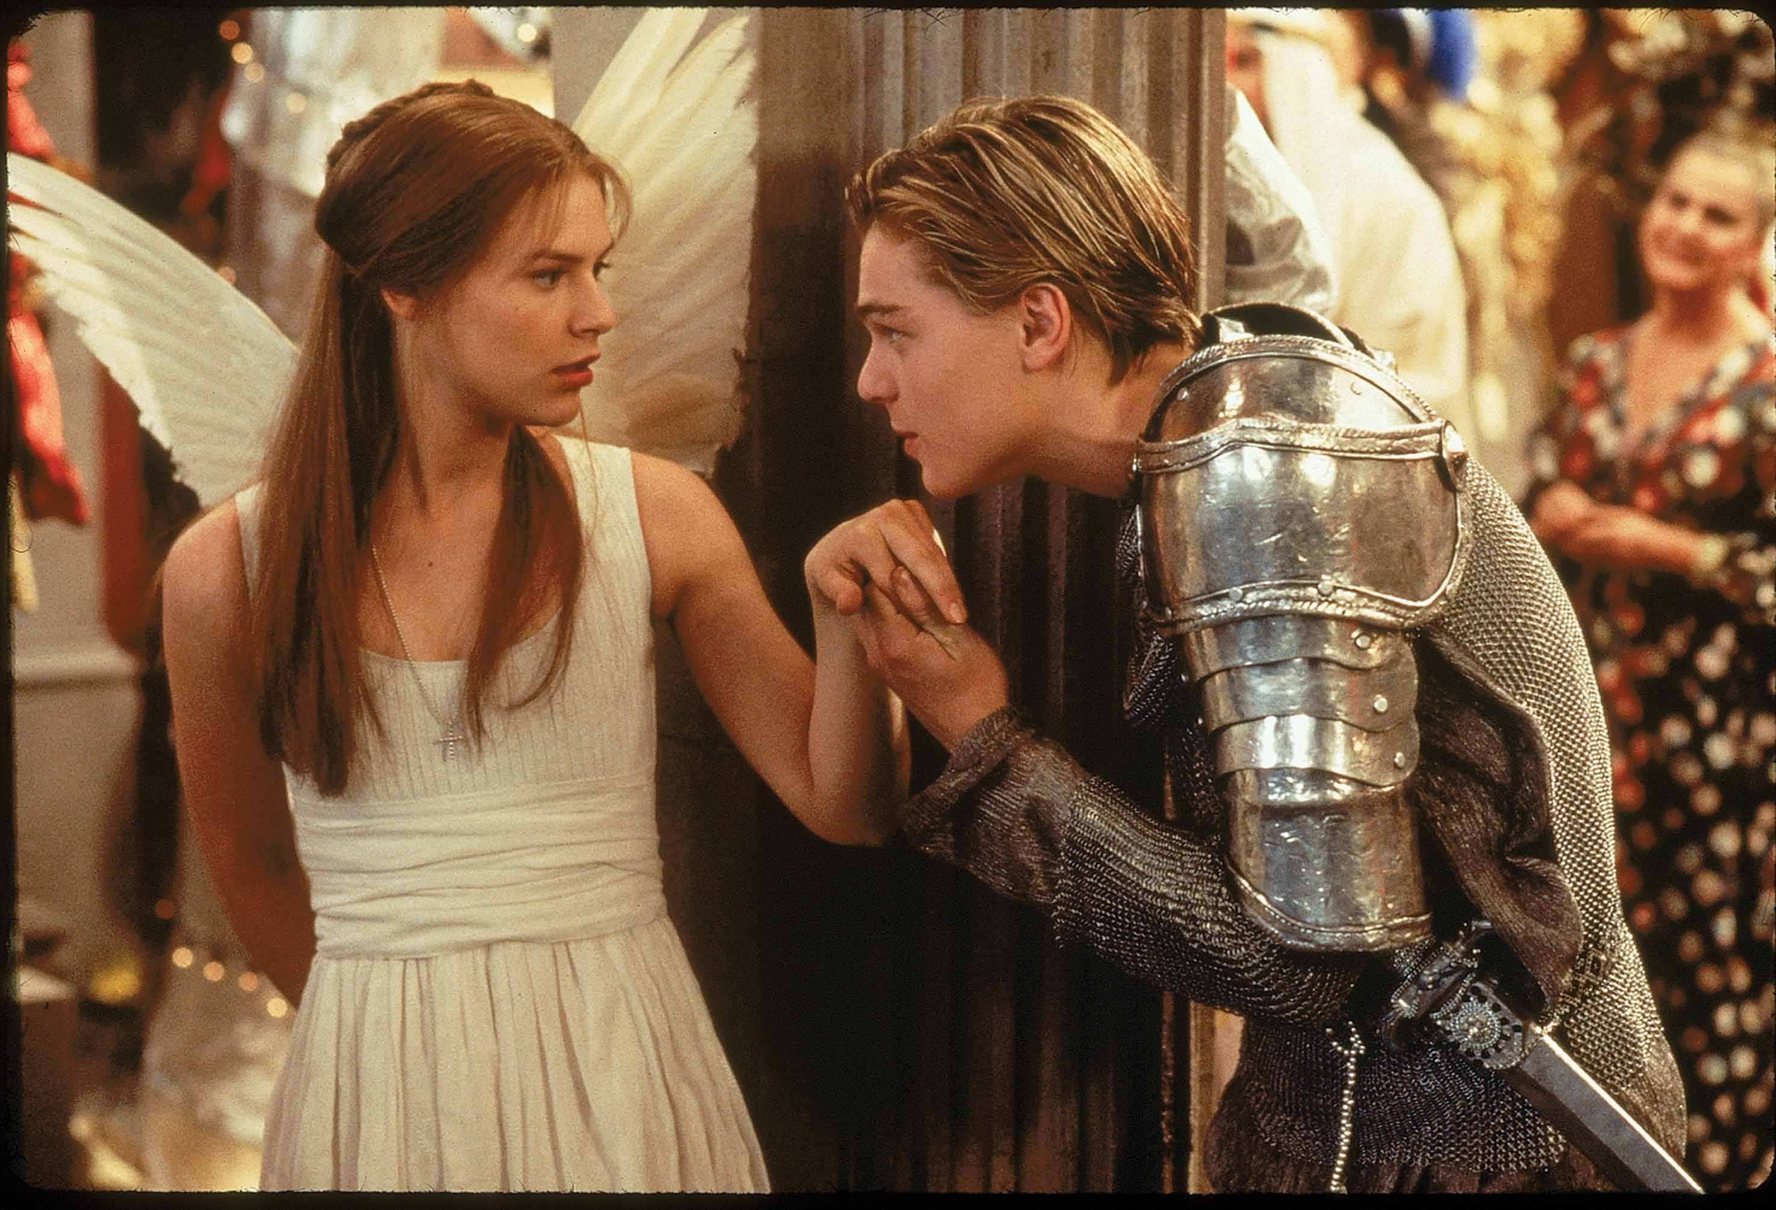
Romeo and Juliet Challenge “A tragic tale of love ended too soon”
200 Word Challenge
Include:
Patriarchy
Repetition
Dramatic Irony
Foreshadowing
Events from across the play with quotes
Opinions
200 Word Challenge
Write about the story of Romeo and Juliet linking
to this statement

Slide 11
Transform: Write a story from the perspective of the soldiers.
Think about:
The senses & emotions created in this stressful time.
How did the feel? What did they see? What was going through their minds? What noises were they hearing?
Consider:
Look up Owen Sheers on YouTube talking about his visit to Mametz Wood: https://www.youtube.com/watch?v=O6D8CEtUxfE
What do you learn from this?
Mametz Wood
For years afterwards the farmers found them – the wasted young, turning up under their plough blades as they tended the land back into itself.
A chit of bone, the china plate of a shoulder blade, the relic of a finger, the blown and broken bird’s egg of a skull,
all mimicked now in flint, breaking blue in white across this field where they were told to walk, not run, towards the wood and its nesting machine guns.
And even now the earth stands sentinel, reaching back into itself for reminders of what happened like a wound working a foreign body to the surface of the skin.
This morning, twenty men buried in one long grave, a broken mosaic of bone linked arm in arm, their skeletons paused mid dance-macabre
in boots that outlasted them, their socketed heads tilted back at an angle and their jaws, those that have them, dropped open.
As if the notes they had sung have only now, with this unearthing, slipped from their absent tongues.
Prioritise: Choose your top five quotes from the poem and explode them with:
Meaning/Effect
Zooming in on a word in the quote
Use triplets to develop your ideas
Focus on context
Exploration of the connotations
Exploration of the context that links & why
Criticise: “The Welsh soldiers were famously left without a proper burial and without being commended for their bravery”
Evaluate what this suggests about the scale of the war and how can this be resolved?

Slide 12
Transform: Select all the imagery examples from the poem and create images that support the words that are being used to create the imagery in your mind.
Write the quote next to the image.
Consider:
The structure of the poem.
Where is the pace quickening?
Why is this important?
Why does Owen use Latin in the final lines and the title?
What message is Owen portraying about war?
Dulce et Decorum Est
Bent double, like old beggars under sacks,
Knock-kneed, coughing like hags, we cursed through sludge,
Till on the haunting flares we turned our backs
And towards our distant rest began to trudge.
Men marched asleep. Many had lost their boots
But limped on, blood-shod. All went lame; all blind;
Drunk with fatigue; deaf even to the hoots
Of tired, outstripped Five-Nines that dropped behind.
Gas! Gas! Quick, boys!—An ecstasy of fumbling,
Fitting the clumsy helmets just in time;
But someone still was yelling out and stumbling
And flound’ring like a man in fire or lime...
Dim, through the misty panes and thick green light,
As under a green sea, I saw him drowning.
In all my dreams, before my helpless sight,
He plunges at me, guttering, choking, drowning.
If in some smothering dreams you too could pace
Behind the wagon that we flung him in,
And watch the white eyes writhing in his face,
His hanging face, like a devil’s sick of sin;
If you could hear, at every jolt, the blood
Come gargling from the froth-corrupted lungs,
Obscene as cancer, bitter as the cud
Of vile, incurable sores on innocent tongues,—
My friend, you would not tell with such high zest
To children ardent for some desperate glory,
The old Lie: Dulce et decorum est
Pro patria mori.
Reading The Prologue
Reading of A1 S1
A1 S5
A2 s2
A3 S1
Final act
Sequencing of the events
Exploring and selecting key quotes for civil war and love
Prioritise: Choose your top five quotes from the poem and explode them with:
Meaning/Effect
Zooming in on a word in the quote
Use triplets to develop your ideas
Focus on context
Exploration of the connotations
Exploration of the context that links & why
Criticise: “The officers and government officials in charge of the war effort were culpable for the unnecessary deaths of many soldiers”
How can Dulce et Decorum Est support or disprove this statement?

Slide 13
War Poems: Possible Exam questions & exercises – remember you can also just do a single poem with the same focus as the comparison question
Extension Tasks
Compare the way two of the poems explore the emotions of the persona (person in the poem)
Compare the presentation of violence in two of the poems
Compare the way the poets write about war
Compare the way women are presented in two of the poems
Compare the mental effects of war

Slide 14
Revision Guide for the Exam Anthology Literature Reading Comparison Tips & Exercises
What you should/could cover in developed concise analysis – RED Minimum, ORANGE Most, GREEN Some (You know which you can aim to include)
Link to the question (RED)
Link to the terminology (Lang/Structure – evaluating choice) (ORANGE)
Short Quote(s) (RED)
Explain meaning and effect – both obvious and hidden (explicit and implicit) (RED)
Zoom in on words/explore connotations and effect (ORANGE)
Suggest what other readers might think/feel (offering an alternative opinion) (GREEN)
Link to the writer’s intentions (step out from the close analysis to give an overview of meaning) (GREEN)
Explore a linking quote/supporting idea (GREEN)
Anthology you will – link to context (RED)
Comparing – use comparison connectives to move onto the next point/idea/quote (RED)
Comparing (similarities) Compared with… Similarly… In the same way… Likewise… Equally… As with… …are similar in that…
Contrasting (differences) However… On the other hand… On the contrary… Instead… As for… Alternatively… Despite this… …whereas… …while... …although… …yet…
Use the Poetry Place Mat on the next page as a
planning guide to help you

Slide 15
Anthology; single poem essay
Timing – plan 5 min. write 15 mins.
Sentence starters: In the poem we see…
this suggests/implies/infers/conveys…
The poet implies/shows… Linking this to the time/place/intentions
Intro – link to question. Explain where meaning of the poem briefly. Can say time period/influences (context)
Throughout the poem – Choose relevant quotes and analyse the language, structure and effect of these quotes. Refer to the question and explain the meaning. Also, link to the context too.
Conclude – Short summary of points
Place your poem here
Plan and decide which quotes to select and which 3 pieces of context you will write about
Exploring the quotes:
Link to the question
Link to the terminology
Link to quote(s)
Explore the hidden and obvious meaning
Zoom in on the words/connotations
Explore the effect
What were the writers’ intentions
Link to context – Explain what it was like at the time. Embed it with your analysis. Explore links to analysis
Terminology: repetition; ideas/words phrases repeated, metaphor; comparison of something as something else, hyperbole; use of exaggeration for effect, imagery; creating a picture in the mind of the reader, simile; comparison using like or as, tone – the impression you are given of how the words sound, emotive language; appeals to reader emotions, personification; makes an object sound human, Use of complex sentences; to explore in detail emotions; pathetic fallacy; sets the tone/mood/atmosphere. End-stopping; punctuation at the end of line, caesura; punctuation in the middle of a line; enjambment; run on lines in the poem; stanza’s; the verses of the poem; layout; how it appears and what effect this has, connotations; implied meanings

Slide 16
Anthology; comparison poem essay
Timing – plan 5 min. write 25 mins. In Year 9 Exam
Sentence starters: In the poem we see…
this suggests/implies/infers/conveys…
The poet implies/shows… Linking this to the time/place/intentions
Intro – link to question. Explain where meaning of the poem briefly.
Throughout the essay– Start with the poem you find you understand most, choose relevant quotes/moments from the poem and analyse the language, structure and effect of these quotes and how they link to examples and analysis from the other poem. You must use connectives of comparison. Refer to the question and explain the meaning. Also, link to the context too for both poems Cover as many quotes from BOTH poems as you can – 25 minutes try to do 3 links between the poems
Conclude – Short summary of what you have said about both poems
Place your poems here
Plan and decide which quotes to select and which 3 pieces of context you will write about
Exploring the quotes:
Link to the question
Link to the terminology
Link to quote(s)
Explore the hidden and obvious meaning
Zoom in on the words/connotations
Explore the effect
What were the writers’ intentions
Use connectives of comparison to show you are aware of the similarities and differences in the poems.
Link to context – Explain what it was like at the time. Embed it with your analysis. Explore links to analysis
Terminology: repetition; ideas/words phrases repeated, metaphor; comparison of something as something else, hyperbole; use of exaggeration for effect, imagery; creating a picture in the mind of the reader, simile; comparison using like or as, tone – the impression you are given of how the words sound, emotive language; appeals to reader emotions, personification; makes an object sound human, Use of complex sentences; to explore in detail emotions; pathetic fallacy; sets the tone/mood/atmosphere. End-stopping; punctuation at the end of line, caesura; punctuation in the middle of a line; enjambment; run on lines in the poem; stanza’s; the verses of the poem; layout; how it appears and what effect this has, connotations; implied meanings

