Slide 1
R1: Response to text
Argument/response is well structured
Focus on the question
Highly accurate and clear response
Critical and thoughtful
engagement with key aspects of the text

Slide 2
R2: Using evidence/comprehension
Quotes are embedded into points
Select individual specific words and phrases
Insightful points are supported with thoughtfully chosen references to the text/quotes

Slide 3
R3: Analysis
Accurate consideration of the meaning and effects created by language, structure and form
Apply a wide range of appropriate techniques.

Slide 4
f
R4: Comparison
Highly secure and thoughtful comparisons
Discussion of both writers’ ideas, use of language, form and structure, terminology and context.
Range of appropriate reference to the texts.
Clear ability to give an overview of the text

Slide 5
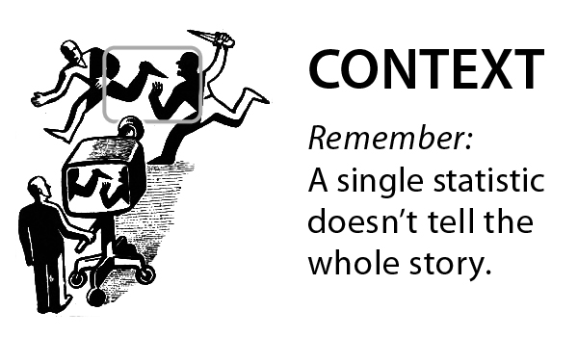
R5: Context
Highly secure and thoughtful discussion of impact of historical context and its relation to the text.
Highly thoughtful focus on audience reaction.

Slide 6
W1 - Organisation
Ideas are organised and developed clearly.
Paragraphs have topic sentences.
There is control, shape and direction to the overall writing, and ideas within paragraphs.

Slide 7
W2 - Writing Development
Some detail and development
Becoming thoughtful in using
Fiction: Plot/Characters
Non-Fiction: Ideas/Arguments

Slide 8
W3 – PAF: purpose, audience & format
Writing is matched to the purpose/format
Shows a clear understanding.
Some appropriate techniques are used.
Clear awareness of the reader / intended audience

Slide 9
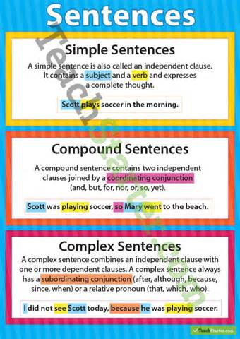
W4 - Sentence Style
Communication is clear and fluent, and becoming ambitious.
A range of sentence starts, lengths and structures are used accurately
Successful use of simple, compound and complex sentences.

Slide 10
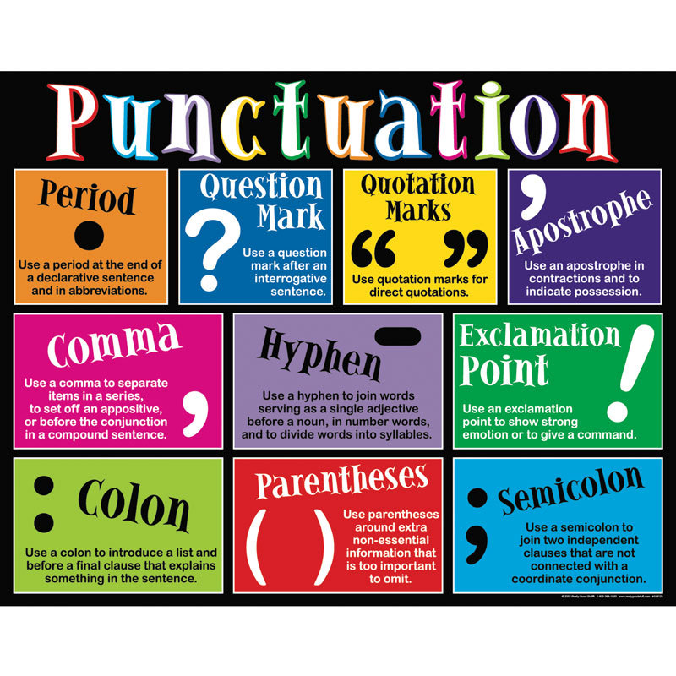
W5 - Punctuation/Grammar
A range of punctuation is used
Grammatical features including the use of tense accurate.

Slide 11
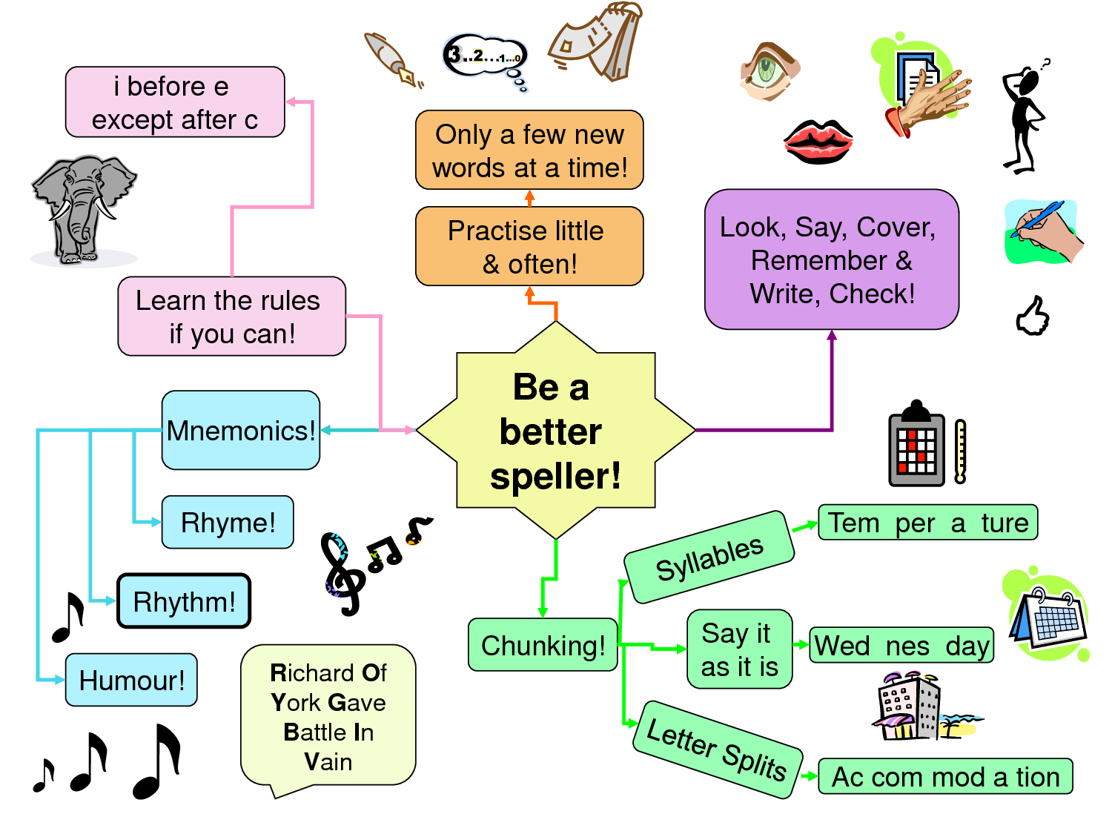
W6 - Spelling and Vocabulary
Spelling is usually accurate across a range of vocabulary
Reasonably wide vocabulary shown
Words choice is precise.

